Slide 1

School of Electrical Engineering and Computer Science
Department of Electrical Engineering
EE-371 : Control Systems
Lecture#03
Transfer Functions of Physical Systems
Chapter #02
Text Book: Control Systems Engineering by Norman S. Nise 5th Edition
Instructor: Ms Neelma Naz
Class: BEE 12 C/D

Slide 2
What is the Control System Engineer trying to achieve? (Analysis and Design Objectives)
First, understand the broader picture of the
application to best apply a suitable control system.
A good control system is a system that will
  generate a response quickly and without oscillation (good transient response),
  have low error once settled (good steady-state response),
  and will not oscillate wildly or damage that system (stability).

Slide 3
Chapter#02
Transfer Functions of Physical Systems

Slide 4
Ways to Study a System
System
Experiment with actual System
Experiment with a model of the System
Physical Model
Mathematical Model
Analytical Solution
Simulation
Frequency Domain
Time Domain
Hybrid Domain

Slide 5
Model
A model is a simplified representation or abstraction of reality.
Reality is generally too complex to model exactly.

Slide 6
What is Mathematical Model?
A set of mathematical equations (e.g., differential eqs.) that describes the input-output behavior of a system.
What is a model used for?
Simulation
Prediction/Forecasting
Design/Performance Evaluation
Control System Design

Slide 7

Black Box Model
When only input and output are known.
Internal dynamics are either too complex or unknown.
Easy to Model
Input
Output

Slide 8
Grey Box Model
When input and output and some information about the internal dynamics of the system is known.
Easier than white box Modelling.
u(t)
y(t)
y[u(t), t]

Slide 9
White Box Model
When input and output and internal dynamics of the system is known.
One should know complete knowledge of the system to derive a white box model.
White Box
u(t)
y(t)

Slide 10
Transfer Functions of Electrical Networks

Slide 11
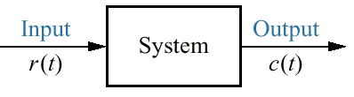
The input, r(t), stands for reference input.
The output, c(t), stands for controlled variable
Physical Laws are used to derive mathematical models of the systems:
Kirchhoff's voltage law : The sum of voltages around a closed path equals zero.
Kirchhoffs current law : The sum of electric currents flowing from a node equals zero.
Newton's laws : The sum of forces on a body equals zero; the sum of moments on a body equals zero.
Kirchhoffs and Newton's laws lead to mathematical models that describe the relationship between the input and output of dynamic systems. One such model is the linear, time-invariant differential equation.

Slide 12
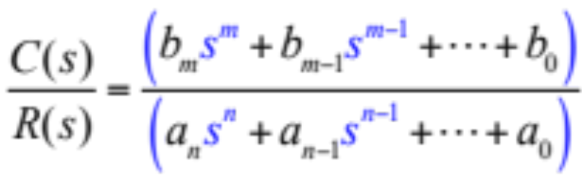
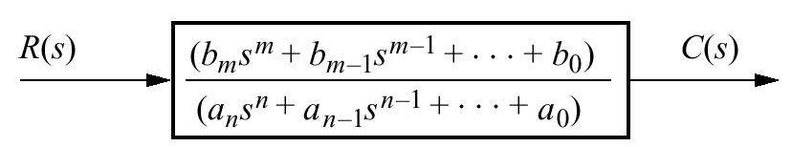

Slide 13
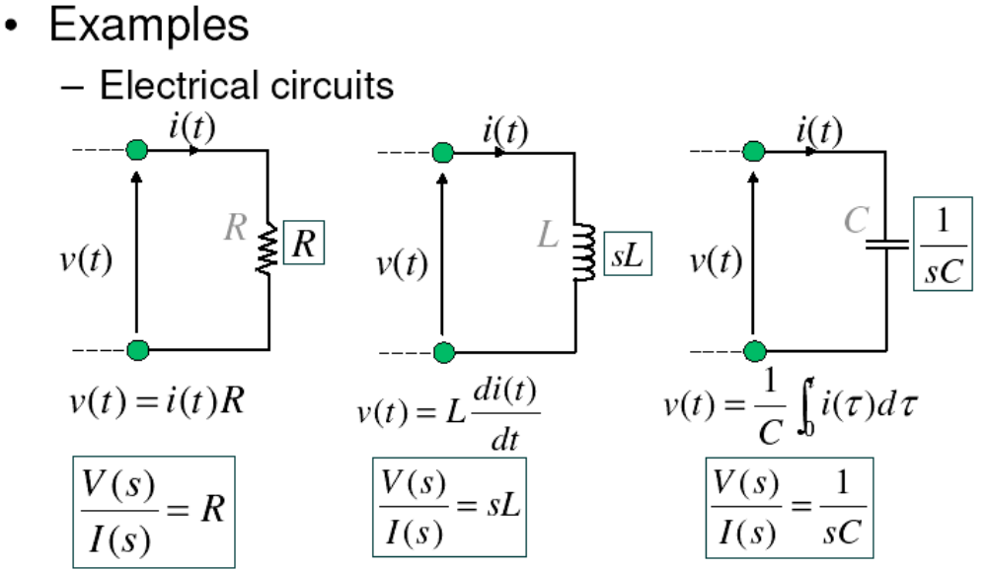
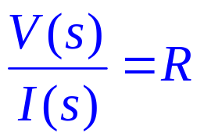
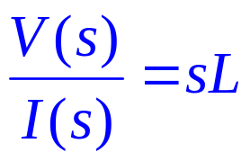
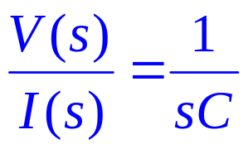
Electrical Circuit Components

Slide 14
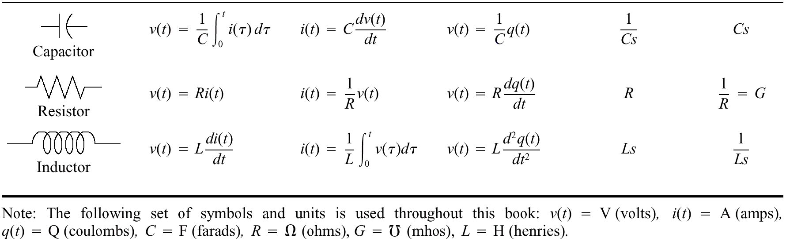
Table 2.3

Slide 15
Table 2.3

Slide 16

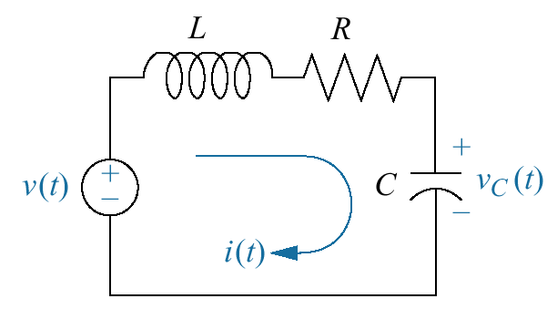
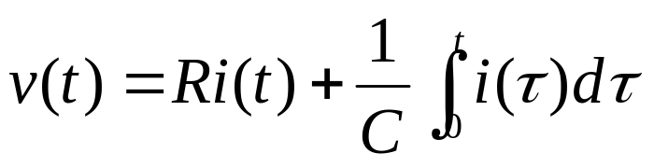
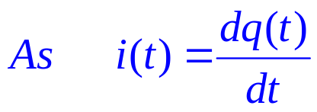
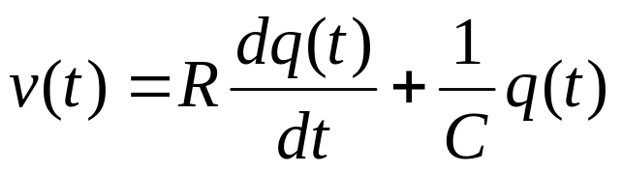
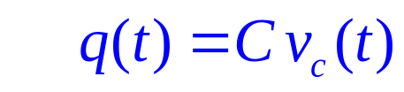
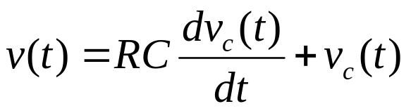
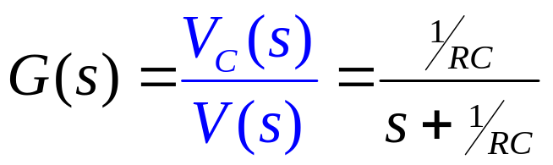
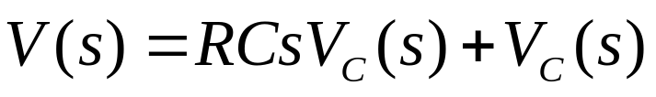
V(s)
V_{C}(s)
G(s)

Slide 17

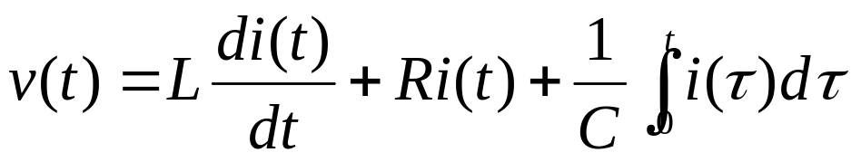
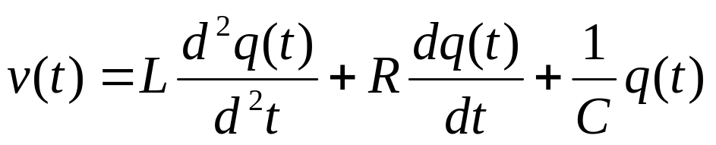

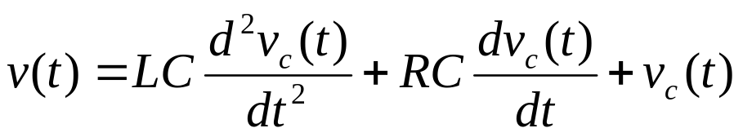
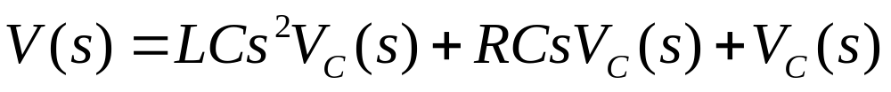
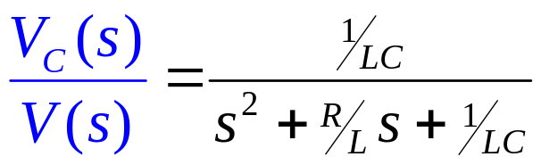
V(s)
V_{C}(s)
G(s)

Slide 18

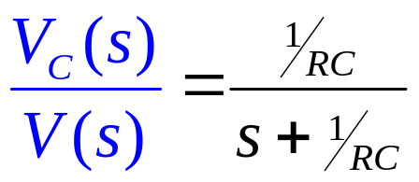
V(s)
V_{C}(s)
G(s)

Slide 19
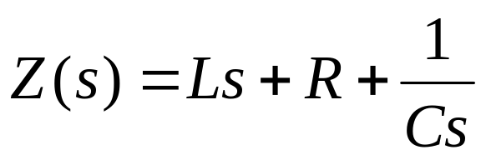

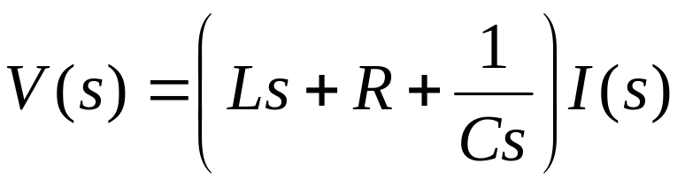
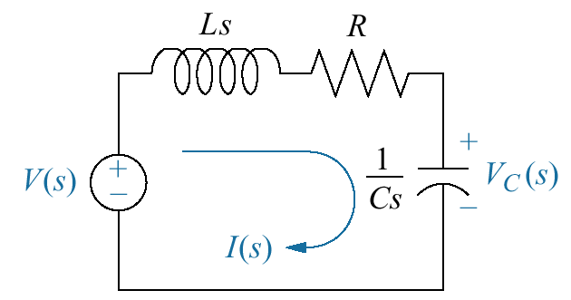
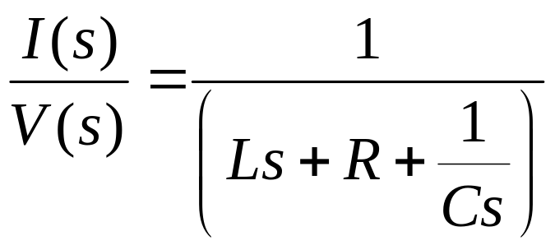
Laplace-transformed network
Trnasform
How do we find V_{c}(s) ???

Slide 20
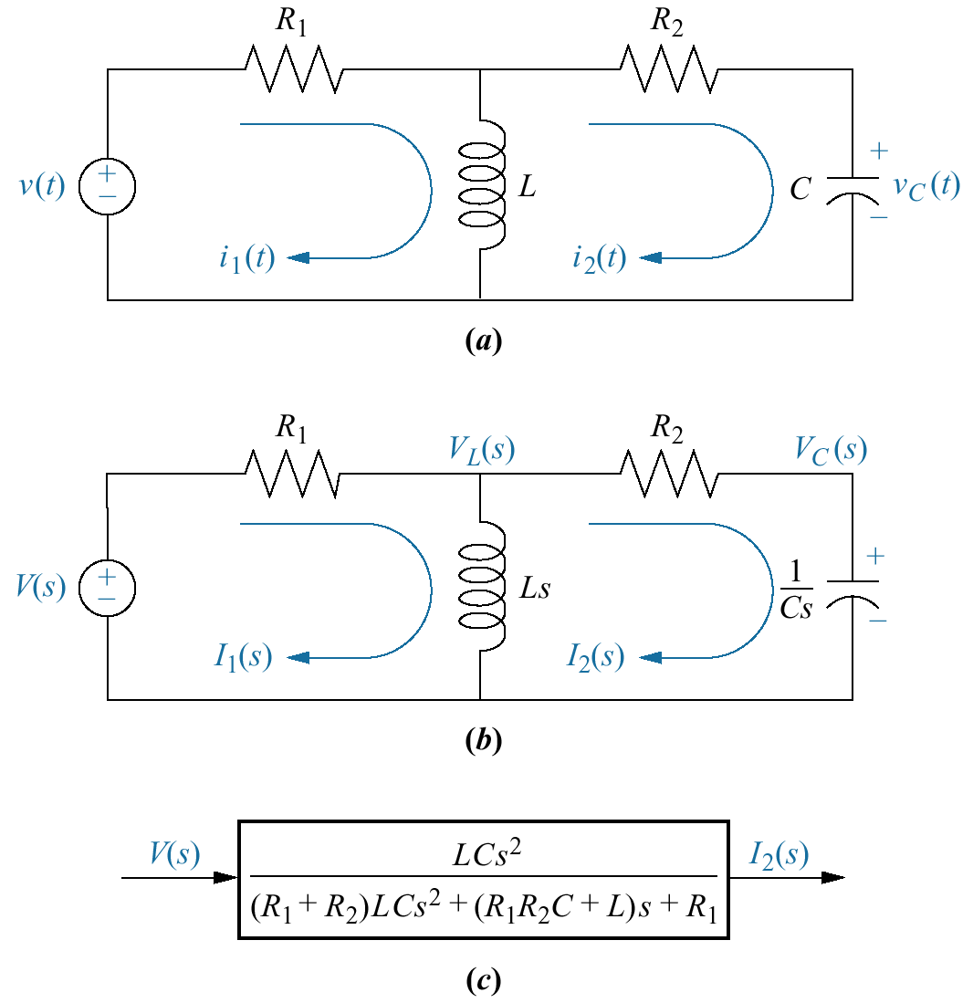
a. Two-loop electrical network; b. transformed two-loop electrical network; c. block diagram
Modeling Complex Circuits via Mesh Analysis
Example 2.10
How do we find the transfer function ???

Slide 21

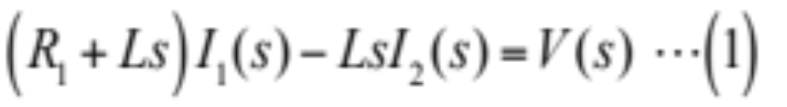
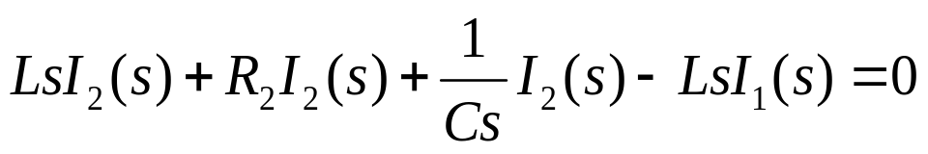
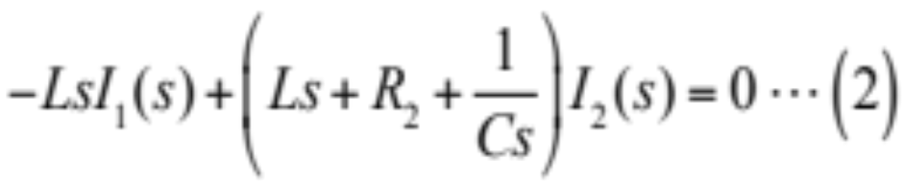
Modeling Complex Circuits via Mesh Analysis

Slide 22
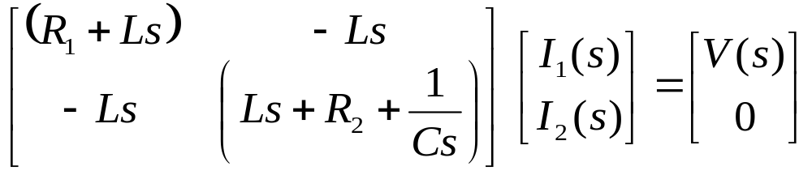
Modeling Complex Circuits via Mesh Analysis

Slide 23
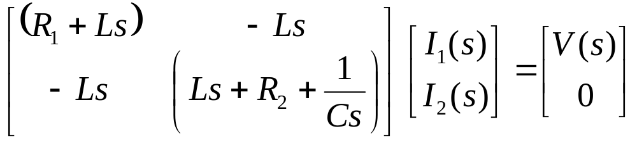
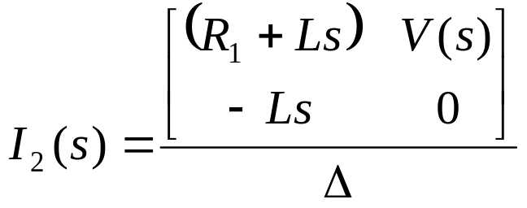
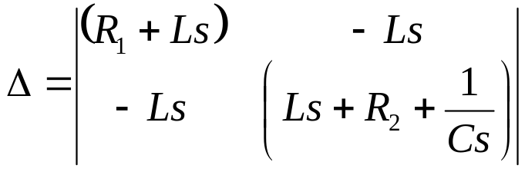
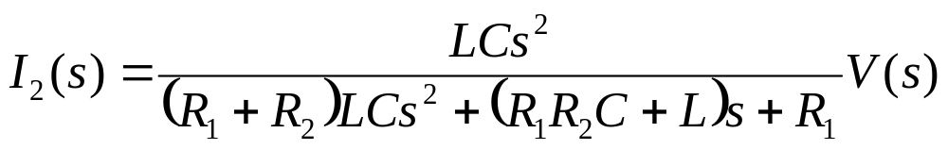
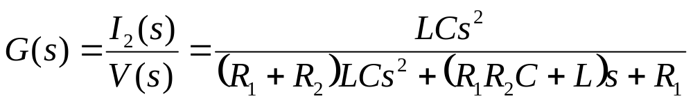
Using Cramer's rule

Slide 24
Home Assignment
(Submit)
Modeling Complex Circuits via
Nodal Analysis
Work out Example 2.11

Slide 25
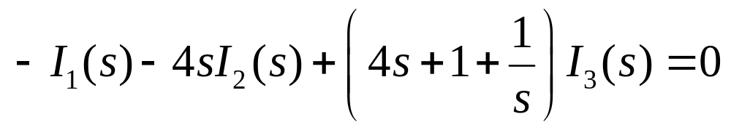
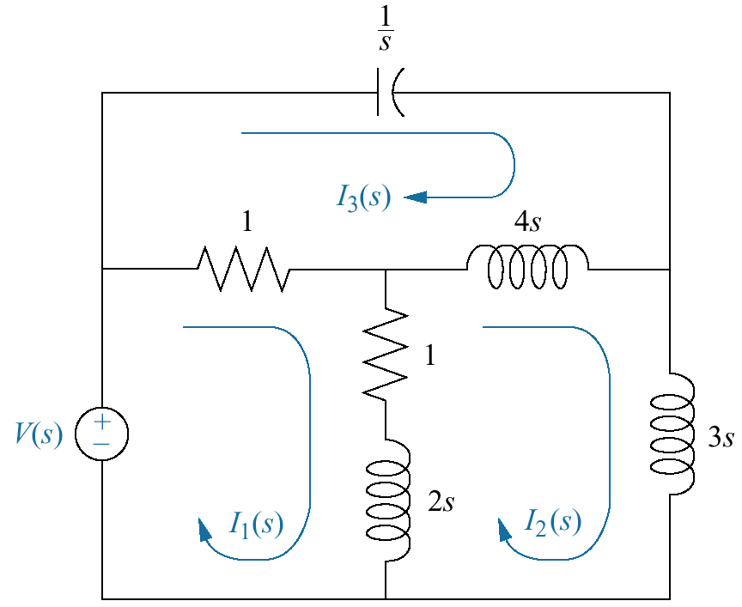
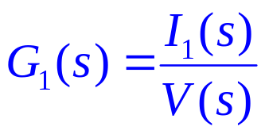
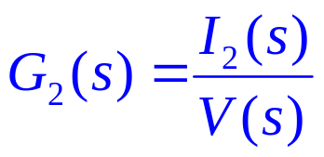
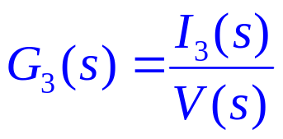
Figure 2.9
Three-loop electrical network
These eqns can be solved simultaneously to determine the desired transfer function

Slide 26


